Slide 1
Hardware and Software Architecture
8086
MICROPROCESSOR

Slide 2
Basic Components
The x86 processor communicates with main memory and I/O devices via buses
  Data bus for transferring data
  Address bus for the address of a memory location or an I/O port
  Control bus for control signals (Interrupt request, memory read/write …)
Each operation must be synchronized by the system clock
Registers are high-speed storage within the processor

Slide 3
The Fetch-Decode-Execute Cycle
Is the basic cycle for instruction execution
  Fetch the next instruction
    place it in queue
    update program counter
  Decode the instruction
    perform address translation
    fetch operands from memory
  Execute the instruction
    store result in memory or registers
    set status flags according to result
Before fetching next instruction, the CPU checks if an interrupt is pending (more on that later)

Slide 4
The Intel x86 Family
The instruction set of the x86 is backward compatible with any one of its predecessors
  new additional instructions are introduced with each new processor
The 8086/8088 runs only in real mode
  segment registers contain the (real) physical address of memory segments
  no protection is provided: a program can write anywhere (and corrupt the Operating System)
  DOS is a real-mode Operating System
  Windows 3.x/95/98/NT are protected-mode OSs that cannot run on the 8086/8088

Slide 5
The Intel x86 Family (cont.)
The 80286 and up can also operate in protected mode
  Provides segmented virtual memory
    segment registers are selectors (indexes) of segment descriptor tables
    each segment descriptor contains the real physical address of a memory segment
  protection levels are provided (a user program cannot write anywhere and corrupt the OS...)
  supports multitasking
The 8086/8088 and 80286 have 16-bit registers.
Later processors have 32-bit registers

Slide 6
The Intel x86 Family (cont.)
The 80386 can also run in virtual 86 mode (in addition to real and protected modes)
  enables to run multiple real-mode programs in separate virtual 8086 machines
The 80386 memory management hardware supports paging
  each segment is partitioned into fixed-size (4KB) pages (that are easier to swap)
The variable-size segments are visible to the programmer but pages are not.

Slide 7
The Intel x86 Family (cont.)
The 80486
  uses a pipeline of 5 stages for decoding and executing each instruction
  uses an internal L1 cache of 8KB
The Pentium
  superscalar design with 2 instruction pipelines (2 instructions can be executed per clock cycle)
  Two internal L1 caches (code and data)
The Pentium II
  uses a L2 cache (typically 512KB) on a separate dye inside the same SEC cartridge

Slide 8
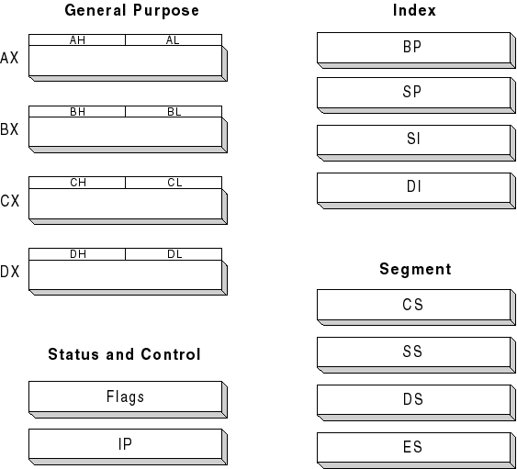
16-bit Registers

Slide 9
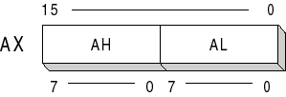
General-Purpose Registers
These are data registers where the upper and lower half can be accessed separately
AX = Accumulator (used in arithmetic)
BX = Base (arithmetic, data movement…)
CX = Counter (for looping instructions)
DX = Data (multiplication & division)

Slide 10
Logical and Physical Addresses
To specify the location of a memory byte we can use either a logical address or a physical address
Physical address: specify its absolute location. This is the number that goes onto the address bus
  For a bus of n lines, physical addresses go from 0 to 2^{n} - 1
Logical address = base:offset
base = location of a block of memory (ex: segment) containing the referenced memory byte
offset (displacement) = location of the referenced memory byte relative to its base

Slide 11
Intel’s x86 Addresses in Real Mode
20 bits are used for physical addresses
  from 00000h to FFFFFh
Logical address = [segment:offset]
Segment = block of memory containing at most 2^{16} bytes located at a physical address which is a multiple of 10h (16d)
  Ex: the segment 08F1h starts at physical address 08F10h
Offset = displacement of the referenced byte relative to its base segment

Slide 12

Intel’s x86 Addresses in Real Mode (cont.)
Ex: a reference byte at logical address 08F1:0100 hex is located at physical address 08F10h + 0100h = 09010h
The base is stored in a segment register
The offset is often stored in a index register but can be stored anywhere else (data register, variable…)

Slide 13
Segment Registers
CS (code segment) holds the base location of all executable instructions in a program
DS (data segment) the default base location for memory variables
ES (extra segment) additional base location for memory variables
SS (stack segment) base location for stack

Slide 14
Index Registers
SP (stack pointer) contains the offset of the top of the stack
BP (base pointer) often contains the offset of a data/variable in the stack
SI (source index) and DI (destination index) are used in string movement instructions
  SI points to the source string
  DI points to the destination string

Slide 15
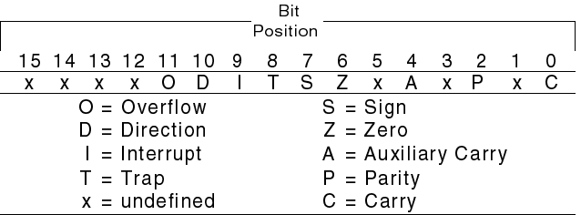
Status and Control Registers
IP (instruction pointer) always contains the offset of the instruction to be executed next within the current code segment
The FLAGS register consist of individual bits indicating either
  the mode of operation of the CPU (control flag)
  the outcome of an arithmetic operation (status)

Slide 16
Real Mode Memory Architecture
Only 1MB of memory is addressable with the 20 bits used for physical addresses
  RAM: from 0 to BFFFFh
  ROM: from C0000h to FFFFFh
The memory above 1MB (extended memory) is addressable only in protected mode
In this course we focus on real mode
DOS is the dominant real-mode OS

Slide 17
Real Mode Memory Architecture (cont.)
The 1st KB of memory (from 0 to 3FFh) contains the interrupt vector table
  each entry of this table contains the segment:offset address of an interrupt handler
  this is the routine invoked when an interrupt has occurred (more later)
  the interrupt handler is normally located in the ROM BIOS
The ROM BIOS (from F0000h to FFFFFh) contains low-level I/O routines and configuration/diagnostic software

Slide 18
Real Mode Memory Architecture (cont.)
The BIOS data area is located (at 00400h) just above the interrupt vector table
  contains serial and parallel port addresses, time and date, keyboard buffer pointers … (for more see table 1)
Next comes more BIOS routines (loaded from io.sys) to manage this data
After comes various parts of DOS
Addresses from A0000h to BFFFFh are located on the video adapter (VRAM)
The rest (< 640 KB) is for user programs

Slide 19
